Slide 1

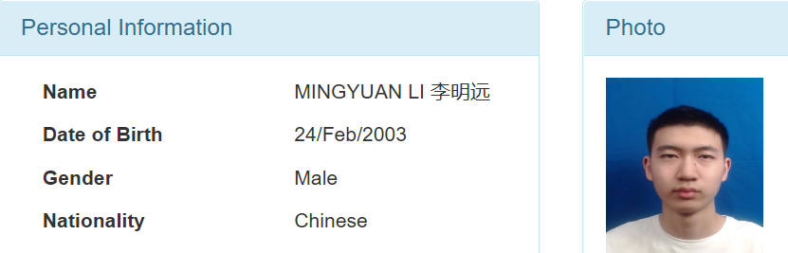

CPT111 CW3 Algorithms Discussion and Analysis
Mingyuan.Li
2022

Slide 2
Outline
Constructor: DnaProfileDiagnosis
Method: readDna
Algorithm: checkProfile
Algorithm explanation and analysis
Running time analysis
Algorithm: diagnoseHd
Algorithm explanation and analysis
Running time analysis
The whole running time analysis

Slide 3
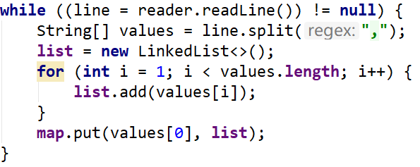
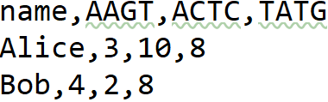
Constructor: DnaProfileDiagnosis
The way to read csv data is cited from CPT111.lecture11
Create database part:
Map:
key-first column of csv
values-a list of remaining columns
List:
remaining columns:
The name of STRs
The quantity of the STR
Key List(Values)

Slide 4
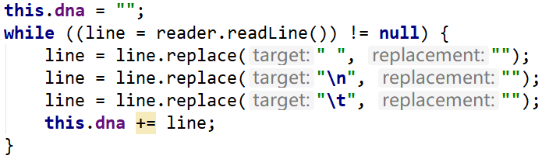
Method: readDna
The way to read file data is cited from CPT111.lecture11
Put all the txt information into a string called dna
Delete whitespace by replace. Change them into null, put each line into dna.

Slide 5


Algorithm: checkProfile
If dna is null, throw the IllegalArgumentException manually.
Initialization
Two main part of this algorithm:
Extract STRs and wrap the values in turn into a new list: dnaTemp
Compare dnaTemp with the STR value of the database, and assign the corresponding key to returnName once it matches

Slide 6
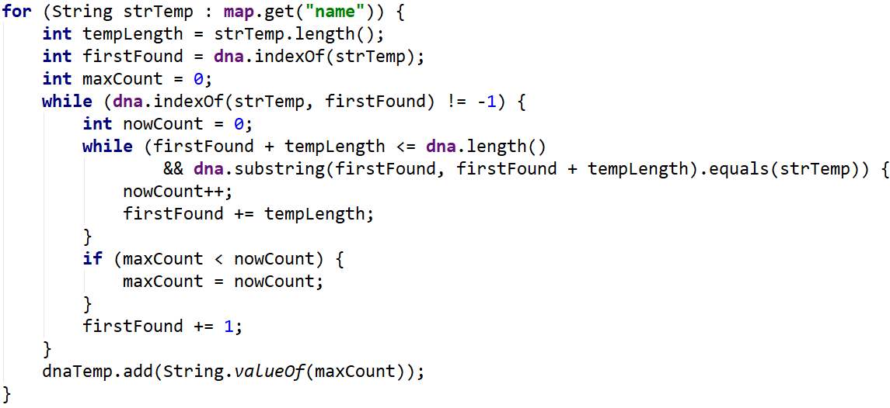
First part of checkProfile
Using enhancing for loop: to find each STR name that need to count.
Find the first appearance of strTemp, mark the index, and start by capturing the next set of strTemp using the substring method
If next set of STR is same to the strTemp, nowCount + 1.
If maxCount is less than nowCount calculated by this loop, then maxCount is assigned the value nowCount
After the loop, we find the quantity of this strTemp in the String dna. Put it into dnaTemp.

Slide 7
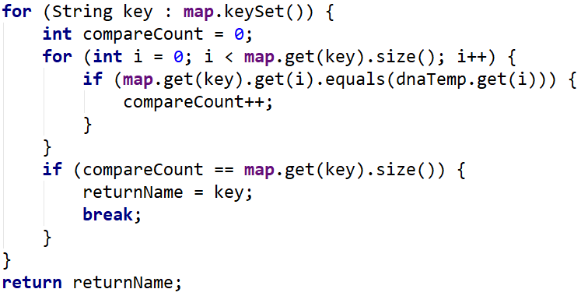
Second part of checkProfile
Using enhancing for loop: find each name of people in the database. (key)
Using for loop: Compare each STRs to see if the number of STRs is the same, since both lists are in the same order. Once they are same, the compareCount + 1.
If every number of STRs is same, that means returnName is same as the size of the list(map.get(key))

Slide 8
Running time analysis of checkProfile
We assume that the length of string is n, the size of the list is m, the STR size is s, the number of keys in the map is y.
Time complexity: O(m*(y+n))
The worst situation:
We using foreach loop to find each name of STRs in the database: m
For each STR:
if there is match: n/s
If there is no match: n
In second part: we using loop to find each key: y
We have to using loop to check every STRs: m
The worst one: m*n + m*y

Slide 9

Algorithm:diagnoseHd
If dna is null, throw the IllegalArgumentException manually.
Initialization
Two main part of this algorithm:
Count the number of CAG repeats
Find the corresponding diagnosis name

Slide 10
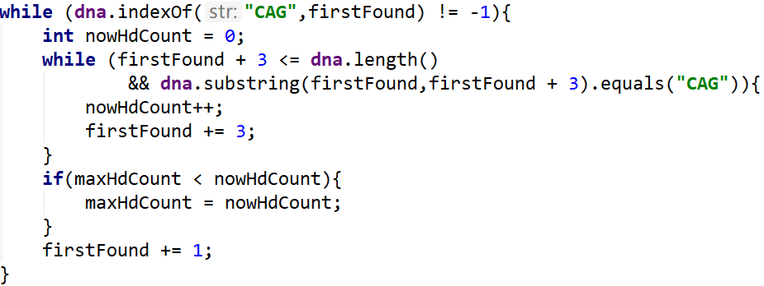
First part of diagnoseHd
Same way as the method checkProfile:
Find the first appearance of CAG, mark the index, and start by capturing the next set of CAG using the substring method
If next set of STR is CAG, nowCount + 1.
If maxHdCount is less than nowHdCount calculated by this loop, then maxHdCount is assigned the value nowHdCount

Slide 11
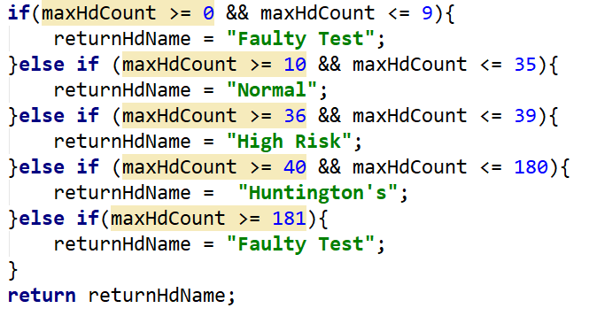
Second part of diagnoseHd
Find the interval in which maxHdCount is located and assign the corresponding String to returnHdName
Return the returnHdName

Slide 12
Running time analysis of diagnoseHd
We assume that the length of string is n, the size of the list is m
Time complexity: O(n)
The worst situation:
We using loop to find each "CAG", there is no "CAG": n
The worst one: n

Slide 13
Running time analysis of DnaProfileDiagnosis
We assume that the length of string is n, the size of the list is m, the number of csv columns is x, the number of keys in the map is y, the number of lines in txt is l.
Time time complexity of profiling and the diagnosis:
O(n+m*(y+n))
The Constructor: O(x*y)
The readDna: O(l)
The whole DnaProfileDiagnosis: O(x*y+l+m*(y+n)+n)

Slide 14
The End
Thanks for listening

